Slide 1

Deep Dive into Large Language Models and Their Applications

Slide 2
目录
●
From Words to Vectors
●
Transformer Architecture Explained
●
Applications of LLMs in Supply Chain Management
●
Integrating Knowledge Graphs with LLMs
●
谢谢

Slide 3
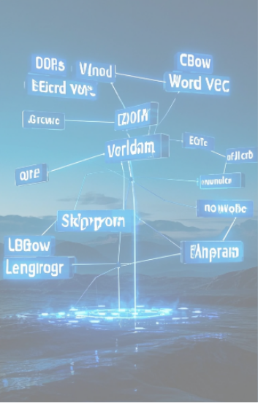
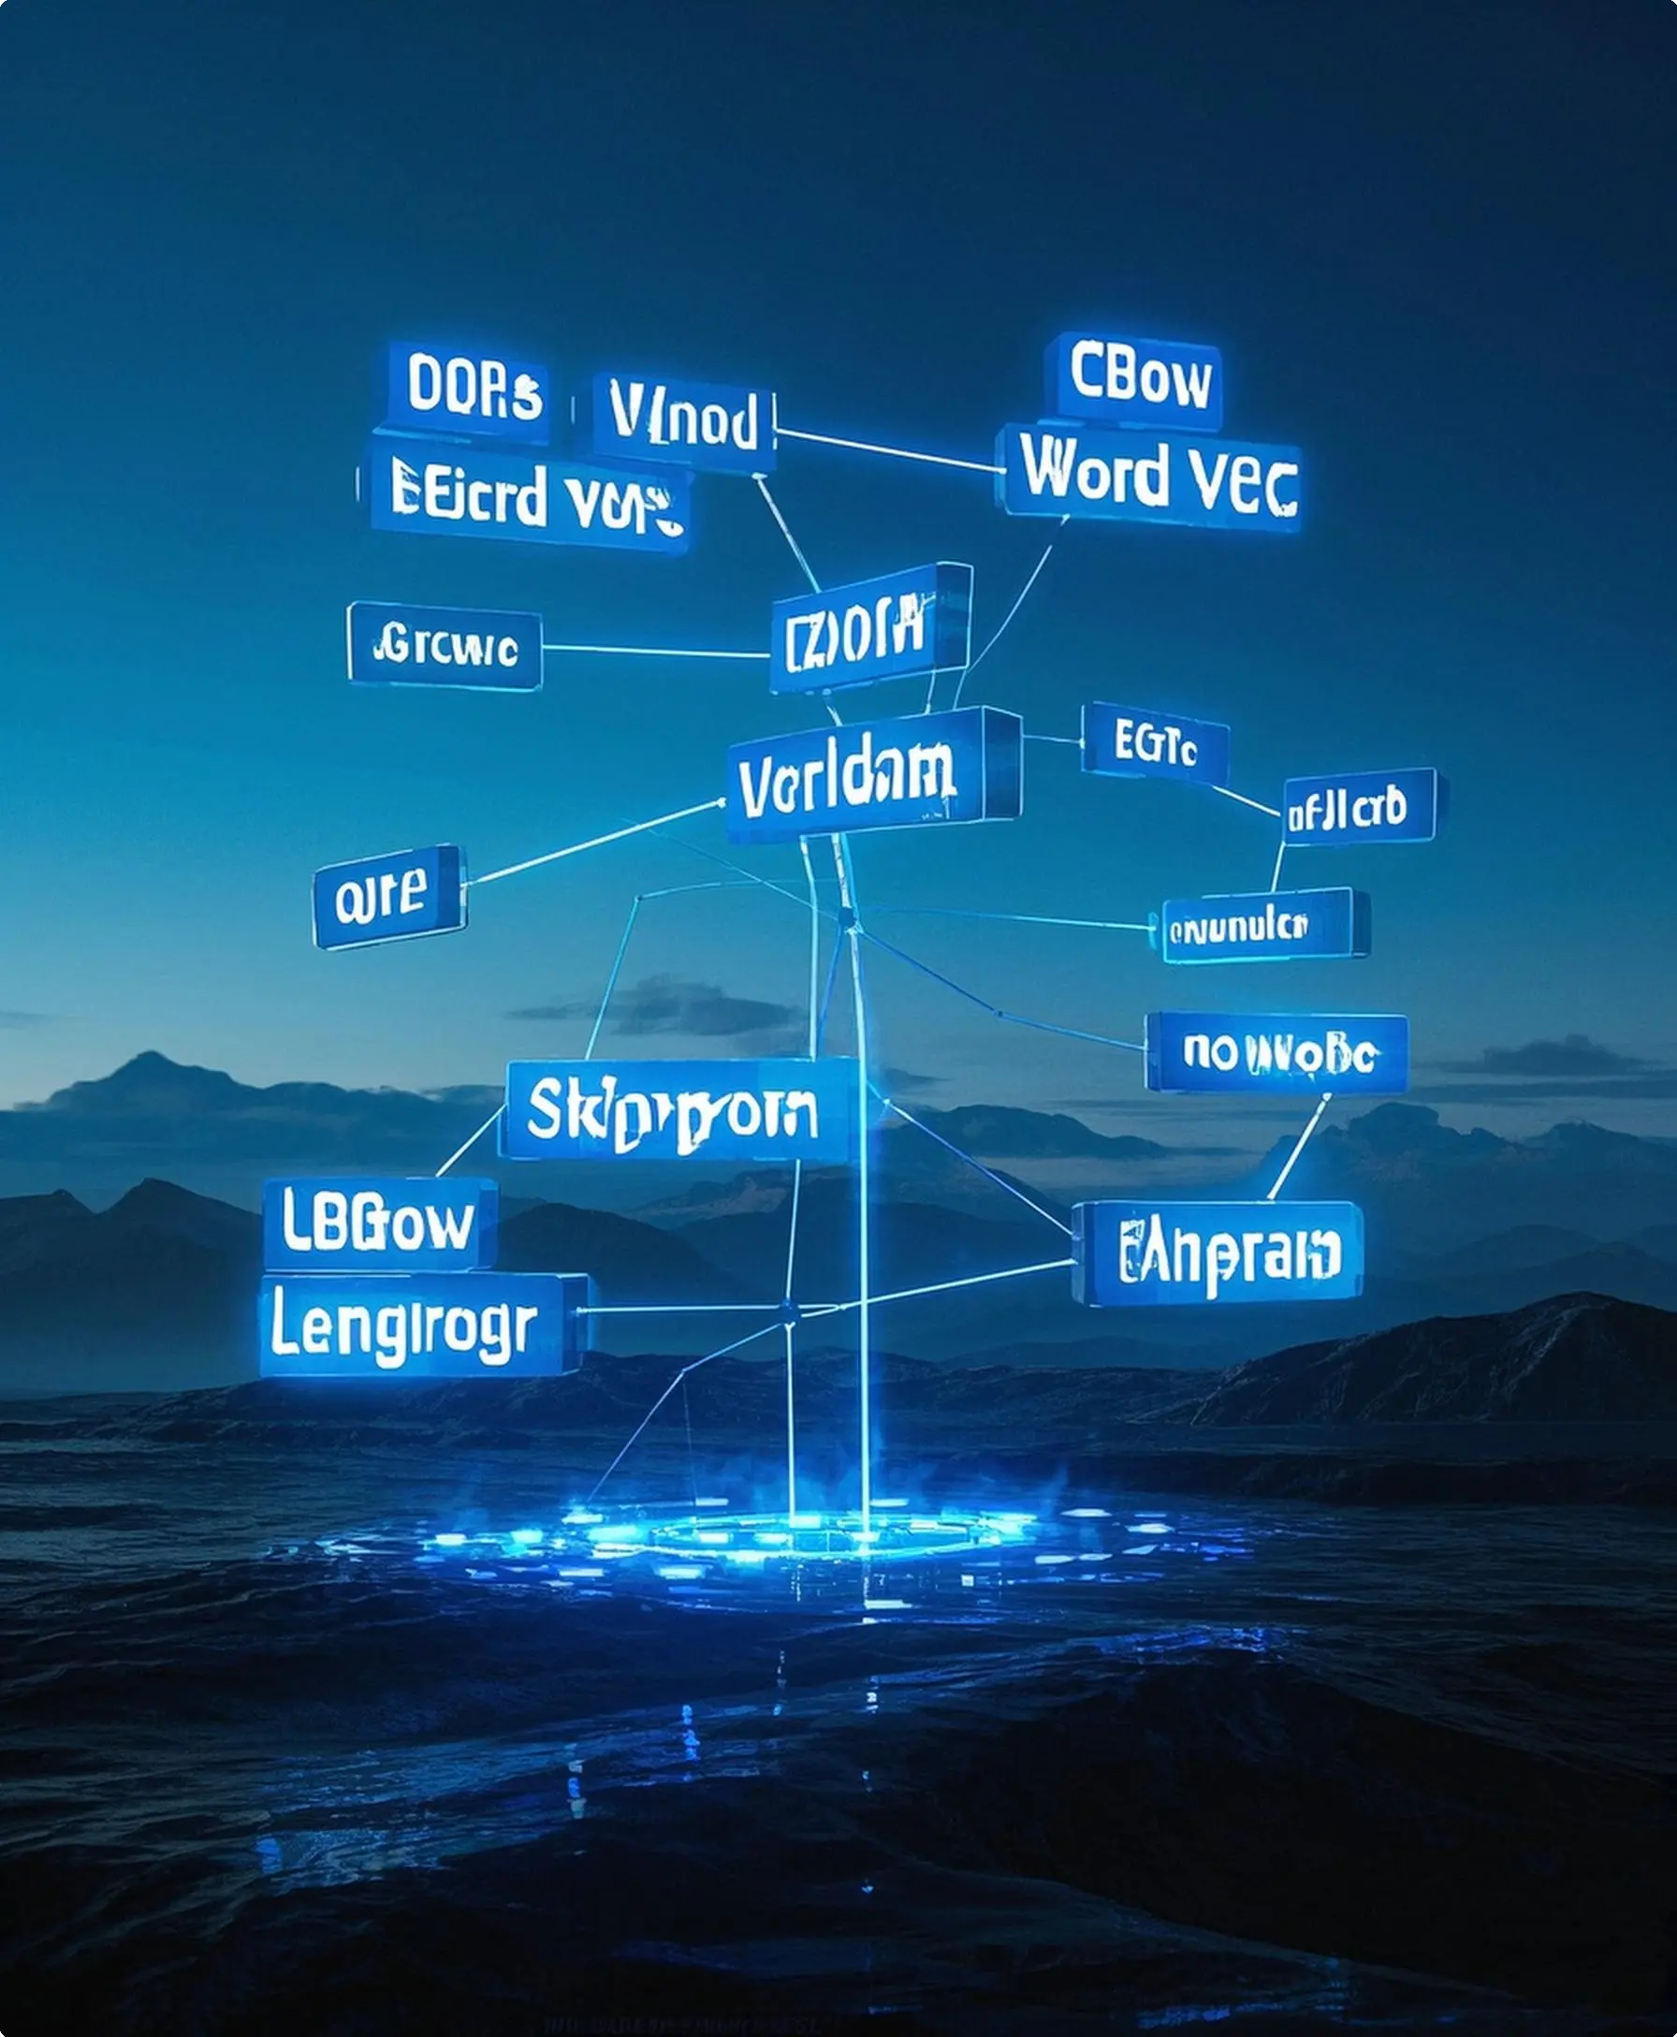
From Words to Vectors
Word vectors are fundamental in representing language data in numerical form, allowing machines to process and understand linguistic information.

Slide 4

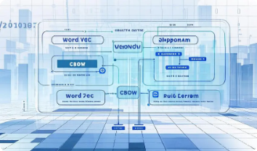
Word Embedding Techniques
1
Word2Vec: Understanding Semantic Relationships
2
Limitations of Static Embeddings
●
**Continuous Bag-of-Words (CBOW)**: Predicts a target word like "inventory" from surrounding context words such as "safety" and "stock."
●
**Inflexibility**: Provides the same vector for a word regardless of context.
●
**Example**: The word "bank" has a single vector, ignoring different meanings in "river bank" vs. "investment bank."
●
**Skip-gram Model**: Focuses on predicting surrounding words from a target word like "supplier" leading to predictions like "lead time."
●
**Contextual Layers Lacking**: Cannot distinguish nuances of semantic shifts in dynamic conversations.
●
**Semantic Mapping**: Translates word meaning into vector space, capturing proximity among semantically similar words.

Slide 5
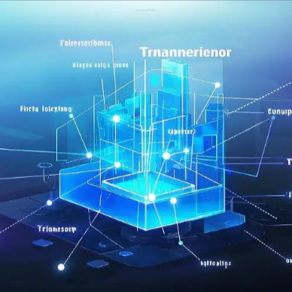
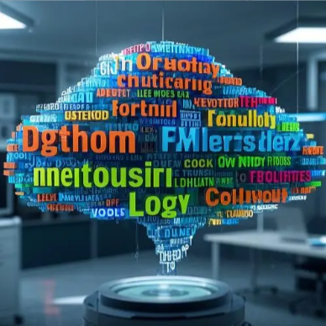
Advanced Word Representations
Transformer Embeddings: Contextual Insights
The Advantage of Dynamic Context
●
**Flexibility in Semantic Interpretation**: Adapts vector outputs to specific usage instances in text.
●
**Attention Mechanism**: Captures dependencies between words in contexts like "supply chain" vs. "power supply" producing different vector outputs.
●
**Dynamic Adjustments**: Offers vectors that reflect the full linguistic richness of words in distinct phrases and entities.
●
**Contextual Depth**: Adjusts embeddings based on preceding and succeeding words, enhancing comprehension beyond static representations.

Slide 6


Transformer Architecture Explained
In-depth understanding of Transformer's structure sets the stage for its extensive applicability in various NLP tasks.

Slide 7
Core Structure
1
Encoder-Decoder Architecture
●
**Encoder Role**: Processes input data like historical sales, converting to high-level features.
●
**Decoder Role**: Transforms those features into actionable outputs like demand forecasts.
2
Role in Natural Language Processing
●
**Textual Sense-making**: Utilizing data hierarchy for precise language interpretation.
●
**Case Application**: Efficiently decodes intricate sentence structures for text generation and translation.

Slide 8
Attention Mechanisms
Self-Attention: Enhancing Contextual Links
●
**Mechanism**: Allocates weights to representations of words, enabling relational mapping within texts.
●
**Example**: In "Delay in Supplier A causes a shortage," links between "Delay" and "shortage" reveal causal relations.
Multi-Head Attention: Capturing Multiple Aspects
●
**Functionality**: Simultaneously focuses on different parts of a sequence to understand nuanced information.
●
**Application**: Aggregates diverse information threads, enriching data interpretation and decision workflows.

Slide 9


Applications of LLMs in Supply Chain Management
LLMs are transforming supply chain processes from data- centric tasks to prediction and optimization mechanisms.

Slide 10


Demand Forecasting
Utilizing Historical and Real-time Data
●
Integration: Combine sales, weather, and promotion data for enriched predictions.
●
Example: Enhanced accuracy by analyzing Q3 demand spikes in the context of competitor activity.
Scenario Simulations and Projections
●
"What-if" Analysis: Simulate potential impacts like tariffs on product performance.
●
Predictive Insights: Generates forecasts with detailed confidence levels, aiding decision- making.

Slide 11
Inventory Management
Dynamic Safety Stock Calculations
●
**Formula**: Adjust safety stock based on variable lead time and demand factors.
●
**Self-learning Models**: Adapt safety measures according to real-time supply chain dynamics and trends.
Real-world Examples of Optimization
●
**Techniques**: Application of predictive models to minimize stock-outs and optimize order quantities.
●
**Case Studies**: Demonstrates improvement in inventory efficiency through LLM-driven insights.

Slide 12
Root Cause Analysis and Risk Management
Identifying Stock-out Causes
●
**Data Sources**: POS data, supply chain communications, and logistic reports.
●
**LLM Role**: Classifies reasons by analyzing patterns like late deliveries or demand forecasting errors.
Supplier Risk Mitigation Strategies
●
**Develop Mechanisms**: Use LLMs to assess supplier stability based on geopolitical and market trends.
●
**Case Integration**: Implementation of contingency planning relying on holistic risk evaluation models.

Slide 13


Integrating Knowledge Graphs with LLMs
Integrating knowledge graphs drastically enhances LLM utility by structuring and linking complex relationships and data insights.

Slide 14
Creating Supply Chain Knowledge Graphs
1
Building Nodes and Relationships
2
Enhancing Data Understanding
●
**Knowledge Synthesis**: Integrates diverse data sources into coherent frameworks.
●
**Nodes**: Represent entities such as suppliers and products.
●
**Edges**: Define relationships like "supplies" or "operates in," creating an interconnected data web.
●
**Insight Generation**: Leverages relationship mapping for strategic decision-making.

Slide 15


Use Cases of LLM and KG Integration
Sustainable Sourcing
Comparative Analysis and Reporting
●
**Query Handling**: Identify environmentally conscious suppliers and evaluate against sustainability metrics.
●
**Functional Assessment**: Provides comparative outlooks on supplier performances and risk factors.
●
**Environmental Assessment**: Generate reports linking supplier practices to eco- friendly certifications.
●
**Tools Used**: Leverages LLM-driven comprehension and knowledge graph databases for deeper analytical accuracy.

Slide 16
谢谢

